Slide 1


Architectural Design
Identifying and putting together the components of your game
Part 2- Example

Slide 2

Example Design:
Space Invaders

Slide 3
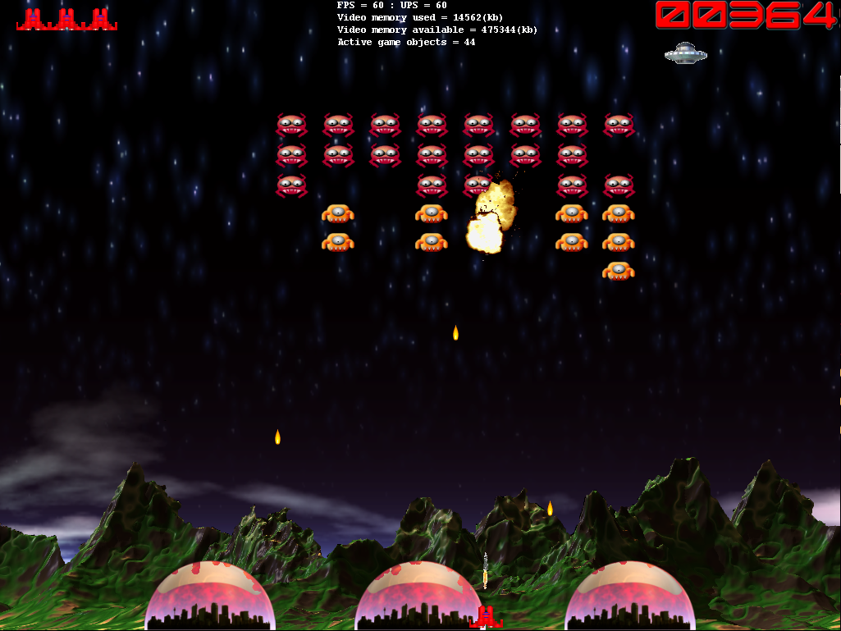
Aside: Space invaders is a simple example of a well defined and understood game.
The normal design process is typically highly iterative and exploratory.
Overlay information / messages
Decorative Effects
Not forgetting sounds… but we will...
Game Objects
Background decoration

Slide 4






: Identifying Objects
Based on our understanding of the game, the following objects might be identified (some core game objects, others supporting objects):
Core Objects
Player ship
Enemy ships
Mothership
Player missile
Enemy missile
Base
Temporal Objects
Explosions
Overlay Objects
Lifes
Score
Decorative Objects
Background

Slide 5
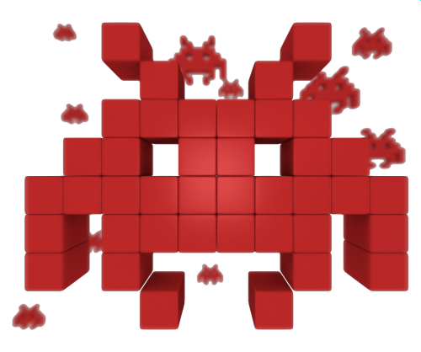
: Object Hierarchies
There are generally lots of different ways to group objects together. Exploit inheritance hierarchies to make development easier and help future expansion.

Slide 6

: Grouping Objects
Background
There are no particularly complex object groupings or interactions.
We could use a dynamic array for the object groupings as objects are not added or removed every frame.
1 of:
Lifes
Score
Bases
Dynamic Array of :
AlienShips
AlienMissiles
InvadersLayer
MotherShip
0 or 1 of:
PlayerShip
PlayerMissile

Slide 7
: Updating and Drawing
scroll background
get input, update position, check fire
update position
remove if needed
check/resolve collision
InvadersLayer
● Update background
● Update player ship
● Update player missile
● Update mothership
● Update alien ships
● Update alien missiles
● Update score
Update
move/appear check
move across/down,
fire check
update position
check/resolve collision
remove if needed
● Draw background
● Draw bases, ships and missiles
● Draw explosions
● Draw score, lifes and messages
Render
Player ship destroyed
● Remove life
● Trigger respawn/ game over

Slide 8
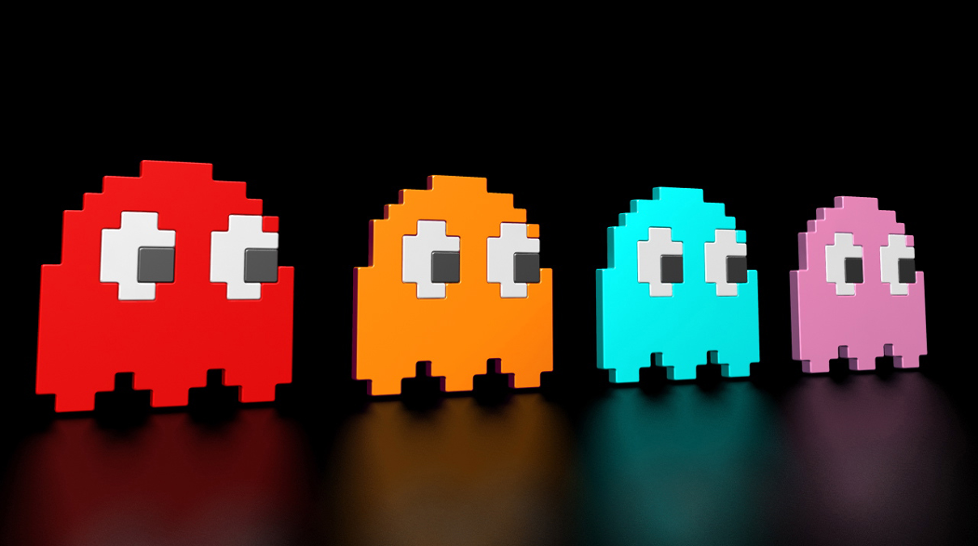
Pac man
Your turn:

Slide 9
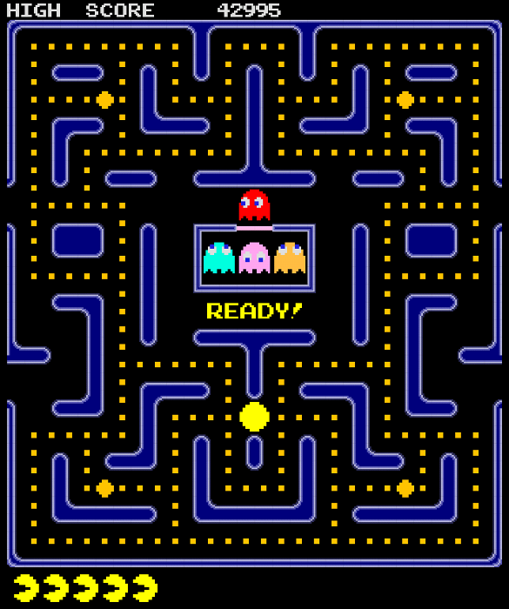
Object Selection:
What game objects are needed to model Pac Man?
Are any linked through inheritance?
What types of data structure are they stored within (if any)?
Start
Update Process:
How would the update game step operate? (assume 30ups)
10 mins
9 mins
8 mins
7 mins
6 mins
5 mins
4 mins
3 mins
2 mins
1 min
30 sec
Finished
Start
10 mins
9 mins
8 mins
7 mins
6 mins
5 mins
4 mins
3 mins
2 mins
1 min
30 sec
Finished

Slide 10

Key takeaways:
In doing this, you take a complex thing (a game) and break it up into more simple parts. Divide and conquer – the essence of all forms of software engineering.

